Slide 1
Smart Hostel &
Mess Administration
Management Information System
A centralized digital platform for hostel, student, fee,
attendance, complaint and mess administration.
TEAM 14 • SECTION S4
M Sai Bhavitha Reddy • 2520030551
Ramagiri Rishik • 2520030333
G. Hitesh • 2520030370
Under the guidance of Dr. Y. Subbarayudu
Assistant Professor, Department of CSE
Koneru Lakshmaiah Education Foundation (Deemed to be University)

Slide 2
01 • OVERVIEW
Project Overview
Why the system is needed and what it brings together.
01
Centralized Management
02
Digital Workflows
03
Better Visibility
A single platform for student records, rooms, fees, attendance, complaints, notices and mess activities.
Moves repetitive hostel and mess activities from manual registers to structured digital workflows.
Dashboards and reports provide administrators with organized operational information.
PROJECT SUMMARY
The proposed system integrates hostel and mess administration into one user-friendly platform, reducing paperwork and improving access to student, accommodation, fee, attendance, complaint and mess information.
Smart Hostel & Mess Administration Management Information System
02

Slide 3
02 • PROBLEM
Problem Statement
Limitations of manual and disconnected hostel administration.
Time-consuming
Data-entry errors
Fee visibility
Student, room, fee and mess records require repeated manual work.
Incorrect or duplicated records can affect allocation, fees and attendance.
Pending payments and payment history are harder to monitor without centralization.
Mess coordination
Complaint tracking
Limited real-time view
Menus, meal participation and food requirements need coordinated records.
Personal reporting can make complaint status and follow-up difficult to track.
Administrators may not have an updated picture of occupancy and operations.
Smart Hostel & Mess Administration Management Information System
03

Slide 4
03 • SOLUTION
Proposed Solution
A centralized workflow connecting users, application logic and MySQL storage.
A
Users & Interface
B
Application Layer
C
Central Database
• Admin
• Hostel / Mess Staff
• Students
Web-based screens for login, records, dashboards, complaints and updates.
• Authentication & access control
• Validation and business rules
• Module workflows
• Dashboard summaries
• Complaint and notice handling
MySQL stores persistent records for:
Students • Rooms • Fees
Attendance • Mess • Complaints
Notices • Reports
Core idea: one consistent source of information for authorized hostel and mess operations.
Smart Hostel & Mess Administration Management Information System
04

Slide 5
04 • OBJECTIVES
Objectives
What the project is designed to achieve.
● Automate student registration and room allocation.
● Maintain student information in a centralized database.
● Manage hostel fee payments, pending fees and payment history.
● Reduce paperwork and human errors through computerized records.
● Provide timely information about occupancy, attendance, fees and mess activities.
● Generate dashboards and reports for administrative monitoring.
● Improve communication between students, hostel staff, mess staff and administrators.
✓
Automation
Digitize repetitive record work.
✓
Centralization
Keep related operational data together.
✓
Communication
Make updates and complaint information easier to access.
Smart Hostel & Mess Administration Management Information System
05

Slide 6
05 • MODULES
Functional Modules
The project is organized into modular hostel and mess services.
Student Management
Room Management
Fee Management
Registration, profiles and student records
Allocation, availability and occupancy
Payments, pending fees and history
Attendance
Mess Management
Complaint Management
Hostel-related attendance monitoring
Menus, meal registration and meal records
Digital complaint submission and tracking
Admin Management
Notifications
Reports & Dashboard
Administrative dashboard and controls
Notices and communication updates
Operational summaries for monitoring
Smart Hostel & Mess Administration Management Information System
06

Slide 7
06 • ARCHITECTURE
System Architecture
.
PRESENTATION LAYER
HTML • CSS • JavaScript
APPLICATION / BACKEND
Authentication • Validation • Business Logic • Module Services
DATA LAYER
MySQL • Structured records • Persistent storage
Authentication
Validation
Centralized Data
Authorized users access the appropriate workflows.
Inputs are checked before database operations.
Modules use persistent MySQL records.
Smart Hostel & Mess Administration Management Information System
07

Slide 8
07 • USERS
Users & Access
Role-oriented access keeps workflows clear for different stakeholders.
1
ADMIN
2
MESS STAFF
3
STUDENT
Manage hostel operations, fees, complaints, notices and reports.
Handle menu, meal registration, meal attendance and feedback-related records.
Access personal hostel/mess information, submit complaints and view updates.
Role-based access concept
● Users interact only with workflows relevant to their role.
● The dashboard provides a consolidated operational view.
● Authentication and access control are part of the proposed architecture.
Smart Hostel & Mess Administration Management Information System
08

Slide 9
08 • TECHNOLOGY
Technology Stack
Technologies documented for the academic project and development environment.
Frontend
Backend
Database
HTML5
CSS3
JavaScript
PHP
(server-side)
MySQL
Development
Platform
Database Tools
Visual Studio Code
XAMPP
Apache
MySQL Workbench
phpMyAdmin
The project report also lists Ubuntu, modern web browsers, and Git/GitHub within the broader development environment.
Smart Hostel & Mess Administration Management Information System
09

Slide 10
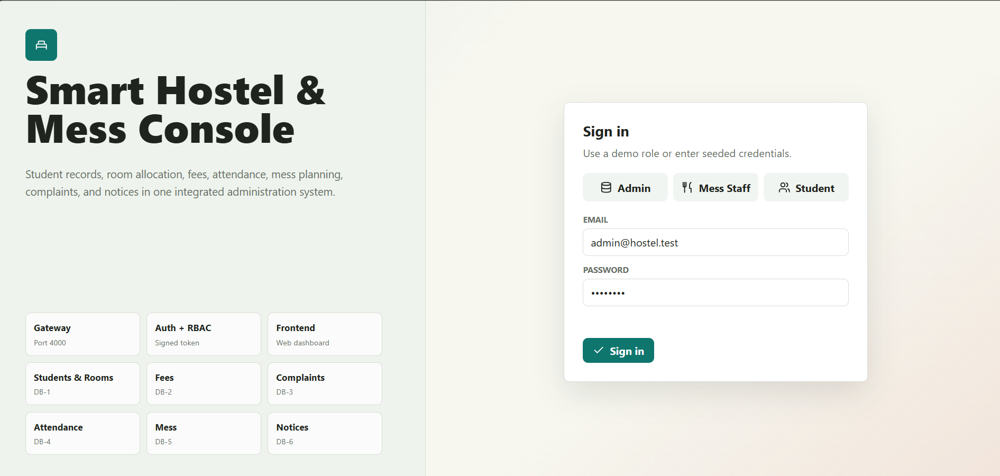
09 • UI
User Interface — Sign In
Prototype screen showing role selection and seeded login credentials.
The interface presents Admin, Mess Staff and Student roles before sign-in.
Smart Hostel & Mess Administration Management Information System
10

Slide 11
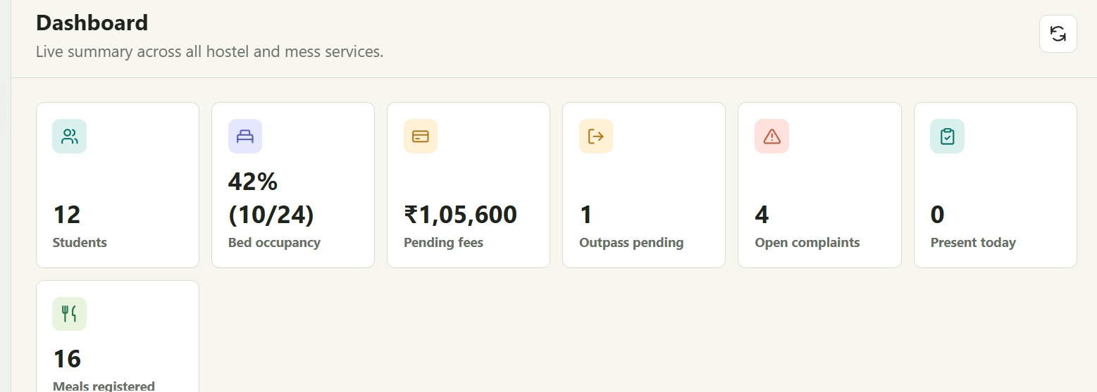
10 • UI
User Interface — Dashboard
Prototype dashboard consolidating key hostel and mess indicators.
Smart Hostel & Mess Administration Management Information System
11

Slide 12
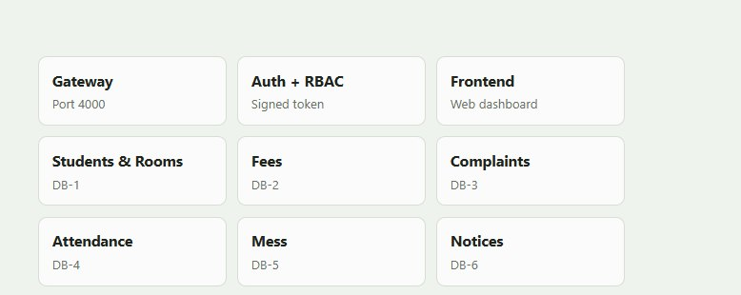
11 • UI
Dashboard & Service Map
The prototype visualizes operational areas as a connected service console.
Gateway
Application entry point shown as Port 4000 in the prototype.
Auth + RBAC
Signed-token and role-based access concepts shown in the prototype.
Service Areas
Students & Rooms • Fees • Complaints • Attendance • Mess • Notices
Smart Hostel & Mess Administration Management Information System
12

Slide 13
12 • WORKFLOW
End-to-End Workflow
A simple flow for common hostel and mess operations.
01
02
03
04
05
LOGIN
REQUEST
VALIDATE
STORE
MONITOR
User selects role and signs in
User opens a relevant service/module
Application checks the submitted information
MySQL creates or updates the record
Dashboard / module displays current information
This workflow reflects the report's separation of frontend interaction, backend validation/business rules and central MySQL persistence.
Smart Hostel & Mess Administration Management Information System
13

Slide 14
13 • FUTURE
Future Scope
Planned extensions identified in the project documentation.
Mobile Application
Online Payments
Student and administrator access on mobile devices.
Integration for hostel and mess fee payments.
Biometric / QR Attendance
AI Food Demand Prediction
More direct attendance capture.
Support food planning and reduce wastage.
IoT Hostel Monitoring
Real-Time Notifications
Monitor electricity, water and room conditions.
SMS, email or mobile alerts.
AI Chatbot
Advanced Analytics
Answer common student queries.
Deeper hostel and mess performance dashboards.
Digital Visitor Management
Cloud Deployment
Track hostel visitors digitally.
Secure access from different locations.
Smart Hostel & Mess Administration Management Information System
14

Slide 15
CONCLUSION
A single digital platform for
smarter hostel & mess administration.
Centralized
One place for operational records.
The project brings student information, accommodation, fees, attendance, mess activities, complaints, notices and reporting into a centralized workflow.
Efficient
Less paperwork and structured workflows.
Extensible
Ready for mobile, AI, IoT and cloud enhancements.
THANK YOU
Questions & Discussion

